Slide 1

Hex game in Tsetlinmachine

Slide 2
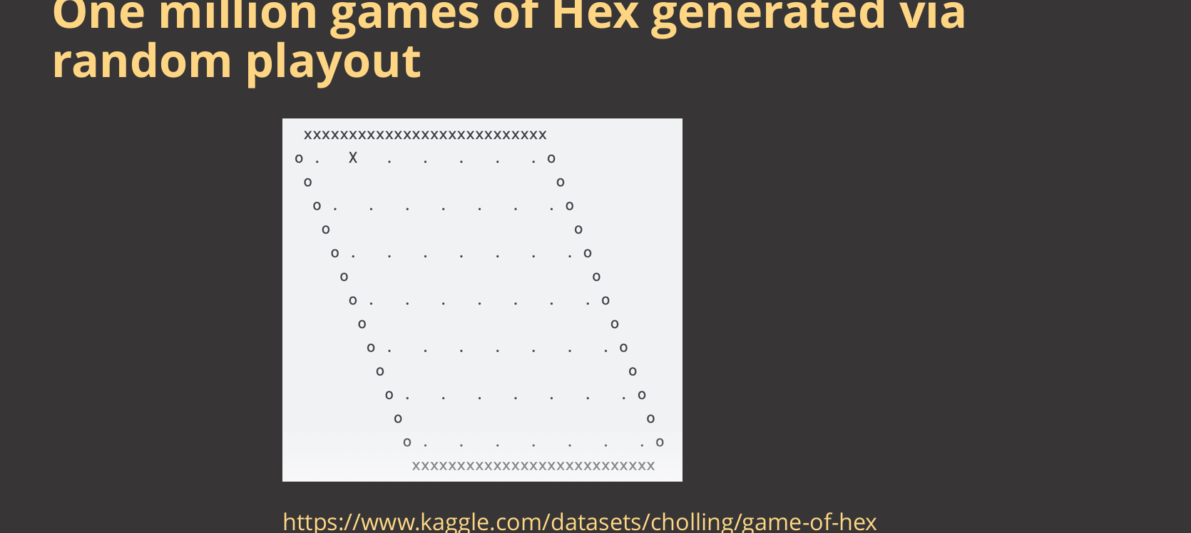
Hex game
-These games were generated using C sample code
- They are saved in an excel file

Slide 3
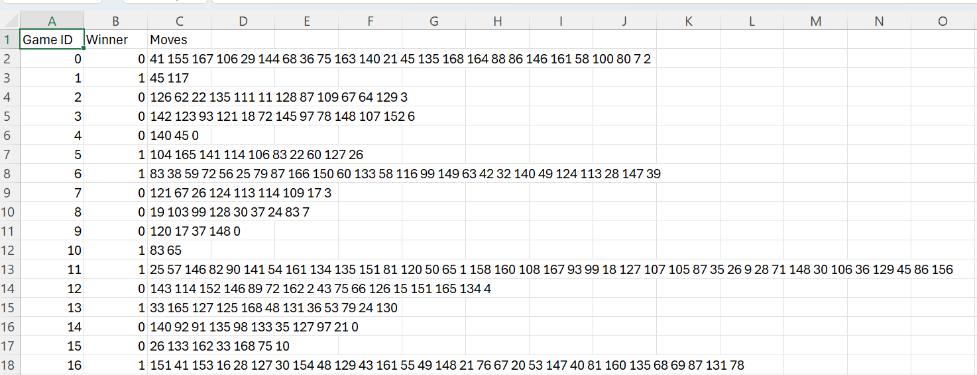
Generated games

Slide 4
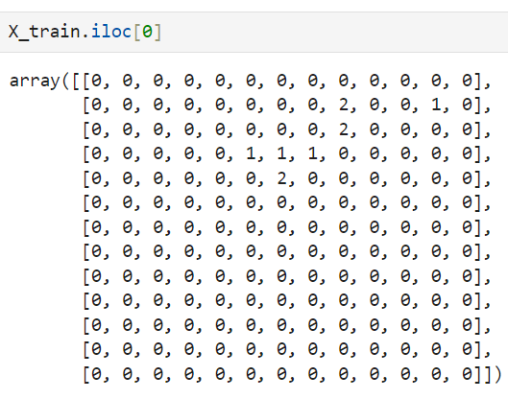
Next Step…
The next step is pre-processing:
To Convert 'Moves' column to lists of integers
To write a Function to convert moves into a final board state in python
To Split the data into training and testing sets.
The last game looks like:

Slide 5
Minst dataset Example
To Read the dataset including 10000 images with size 28*28
To Split the dataset(8000 train and 2000 test)
To Convert each image to a graph
To Encode each graph with useful features which helps tsetlinmachine to predict--->encoded_ train _graph
Encoded train gragh is generated and training starts using MultiClassGraphTsetlinMachine from library

Slide 6
Next step
Based on what Vojtech said: a good start would be encoding the state of the board into the Graph Tsetlin Machine. Similarly to the example, where we encode row and column, and then Patch pixel symbol:
# Column and row symbols
for i in range(dim):
symbol_names.append("C:%d" % (i))
symbol_names.append("R:%d" % (i))
# Patch pixel symbols
for i in range(patch_size*patch_size):
symbol_names.append(i)
(

Slide 7
encode_hex_board function
We must encode some Information like, this cell is touching the edge wall of a red / blue player, this stone is this far from its wall etc. They can help the TsetlinMachine make proper prediction.
symbol_names = []
for i in range(board_size):
symbol_names.append("C:%d" % (i)) # Column symbols
symbol_names.append("R:%d" % (i)) # Row symbols
# Add player and wall symbols
symbol_names.append("Player1")
symbol_names.append("Player2")
symbol_names.append("TouchingRedWall") #the node is near or far from the walls?
symbol_names.append("TouchingBlueWall")

Slide 8
encode_all_games
To write a function to encode all graphs(games)

Slide 9
Training the encoded grapghs
training step: is done using: from GraphTsetlinMachine.tm import MultiClassGraphTsetlinMachine

Slide 10
Test and evaluation
The final step is to evaluate using prediction on test dataset

